Slide 1

3D Printed Smart plant base (smart home)
Kaarthik Raja S(211417104103)
dhana akarshan v(211417104050)
Anerudh r(211417104017)

Slide 2
Abstract
Whether it be for work or pleasure, travelling is always a whole lot of fun. It gives us new experience and opportunities to grow as a “Human”.
But what about the growth of your house plant’s while your away. Or what if your in home and you forget to water it or over-water it. That’s going to be a bummer.
I have the perfect solution for all these problem’s, why not make an automatic watering system?
This Arduino based, uses a moisture sensor to measure the moisture level of the soil, the sensor is stuck into the soil and then flashes LEDs and provides an OLED display readout telling you whether you’re over or under watering your plant.
The LED emits red light when you forget to water it and it waits for a while and if you don’t show up to water your plants, it automatically waters it.

Slide 3
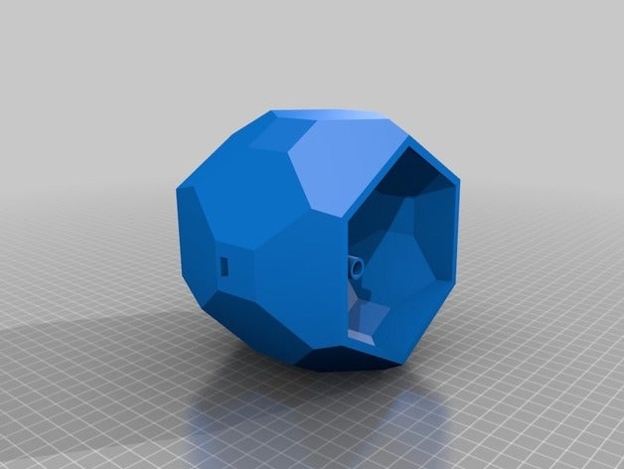
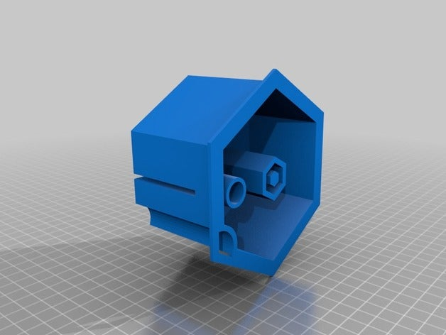
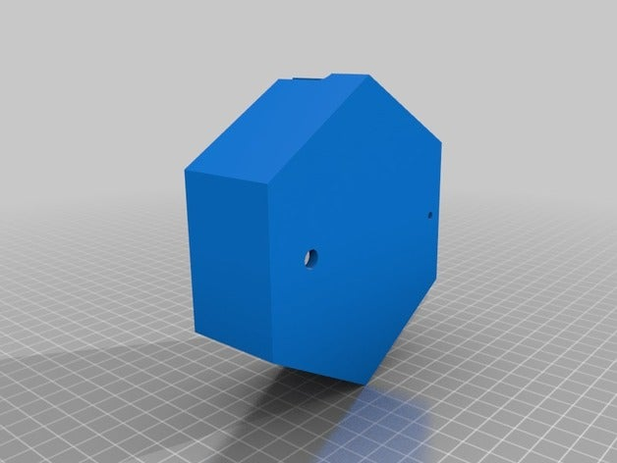
Abstract
This 3D printed ”Automatic Smart Plant Pot” looks simple on the outside, but inside there are electronics, pumps, and a water reservoir that work together to keep your plants healthy and happy.
With this I’ve also attached the yet to be 3D-Printed model of the base

Slide 4
Objective
The main objective of this project is to water the plants or your garden automatically using microcontroller
Water conservation is one of the major objectives of this project.
We can automatically water the plants when we are going on a vacation or stuff.
We don’t have to bother our neighbor’s, friends or relatives, sometimes people tend to over water the plants and in such an event the plants end up dying.
In large scale it can used in assisting in the growth of agricultural crops, maintenance of landscapes, and re vegetation of disturbed soils in dry areas and during periods of inadequate rainfall.

Slide 5
Technology Stack
Aside from the 3D printed components, here’s what else we need to build the self-watering smart planter:
Arduino Nano
Mini sub-emersible pump
Water level sensor
Soil moisture sensor
AWS Cloud
Half Perma-protoboard(Bread Board)
Two potentiometers on the monitor which allows you to set a maximum and minimum moisture level which then activates either the red LED, to indicate a low moisture level, or the yellow LED on a high moisture level, to tell you that you’re overwatering your plant. You can also push the button next to the display to turn on the OLED display and to see the exact moisture level as well as the two set points.

Slide 6
Functionality
An automatic plant watering system using microcontroller is programmed such that it gives the interrupt signals to the motor via the relay.
Soil sensor is connected to the Arduino board which senses the moisture content present in the soil.
Whenever there is a change in the moisture content of the soil, the sensor senses the change, giving signal to the microcontroller so that the pump(motor) can be activated.
Automatic plant watering systems are convenient, especially for those who travel.
If installed and programmed properly, automatic irrigation systems can even save you money and help in water conservation.
Saving money in the sense, dead lawn grass and plants need to be replaced, and that can be really expensive. But automatic watering system is a one time investment.

Slide 7
Benefits of this project
Free yourself from manual labor.
Prevents Weeds and diseases.
Preserves soil structure and nutrients.
Just the right amount of water will be released, While having a Lush Garden. (Unlike when you hand water, when you can easily use more water than you need.)
The water will be directed to exactly where it is needed. (Unlike with hand watering, when you can easily waste water by splashing it around where plants roots cannot retrieve it easily).
An automatic shut off can help to keep water usage to a minimum.

Slide 8
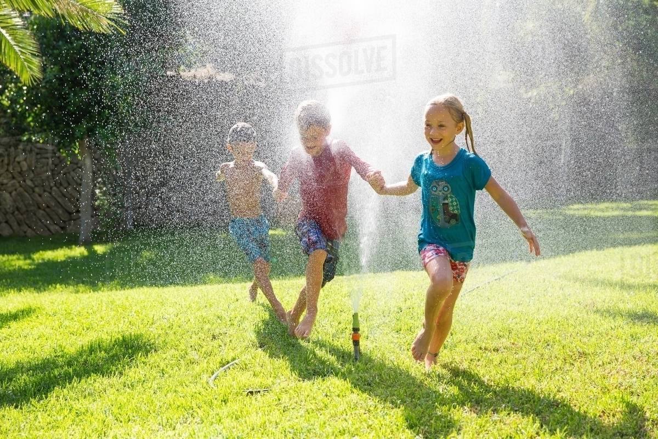

Problems Identified in The Current Product
These systems can be quite costly depending on the size of the property. Furthermore, portions of the lawn will have to be dug up to install pipework and attach it to the plumbing system of the home. This can equate to days or weeks without use of the yard.
Once the water in the tank runs out, the user must manually pour water in the water tank.
No user interface so you won’t know whether the plant has been watered or not.
A research by MIT has proved that 80% of water being sprayed by the current system is being wasted or sprayed in unwanted areas.

Slide 9
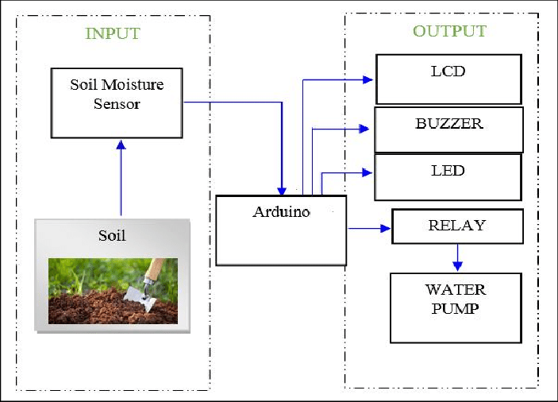
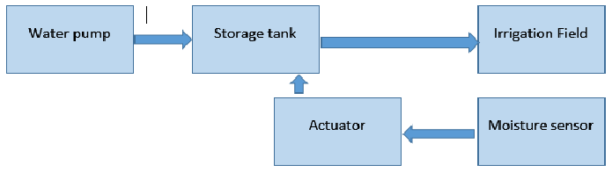
Block Diagram of the current model

Slide 10
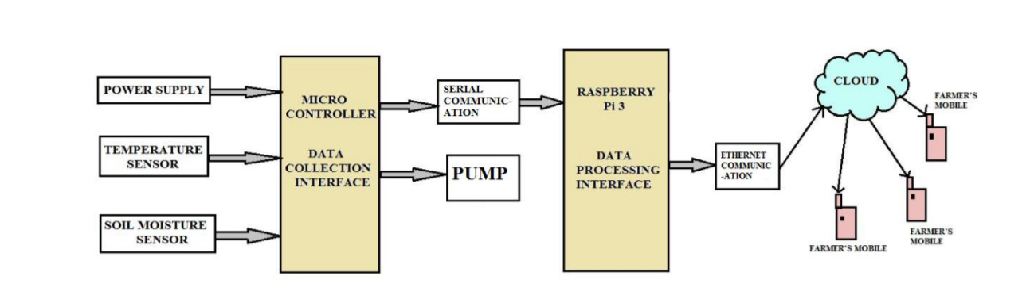
Updated Block diagram
Arduino Nano

Slide 11
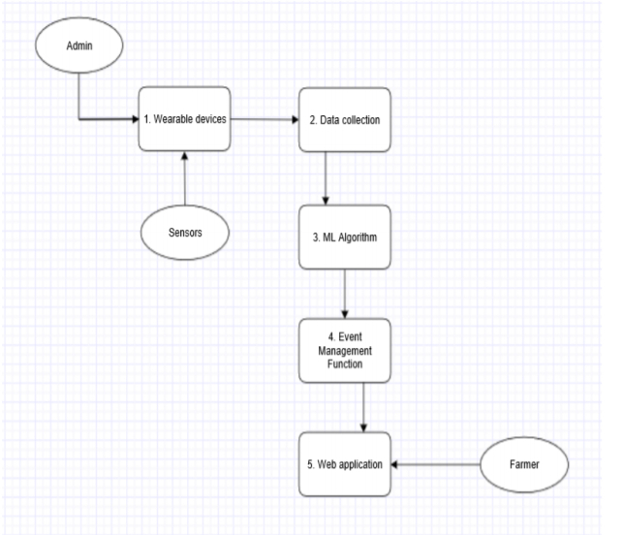
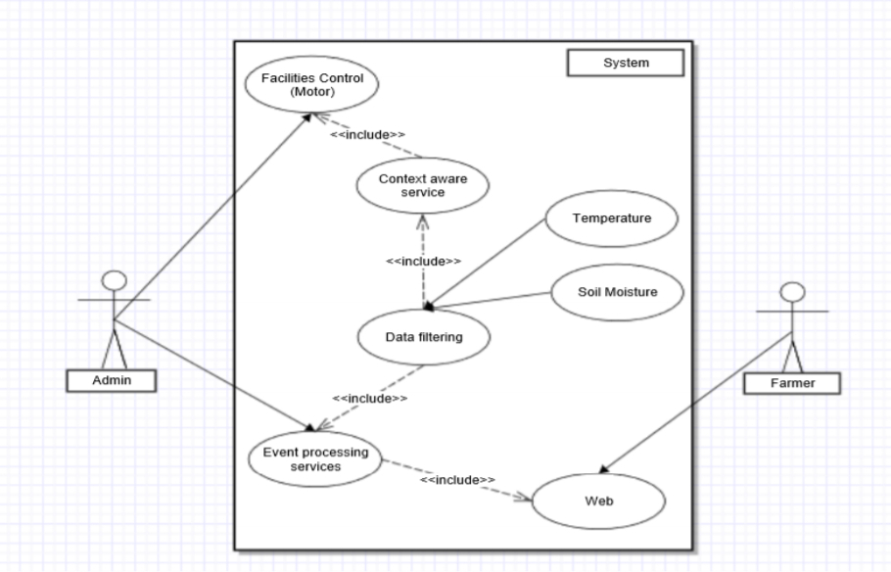
Data Flow diagram and use case diagram
User Interface

Slide 12
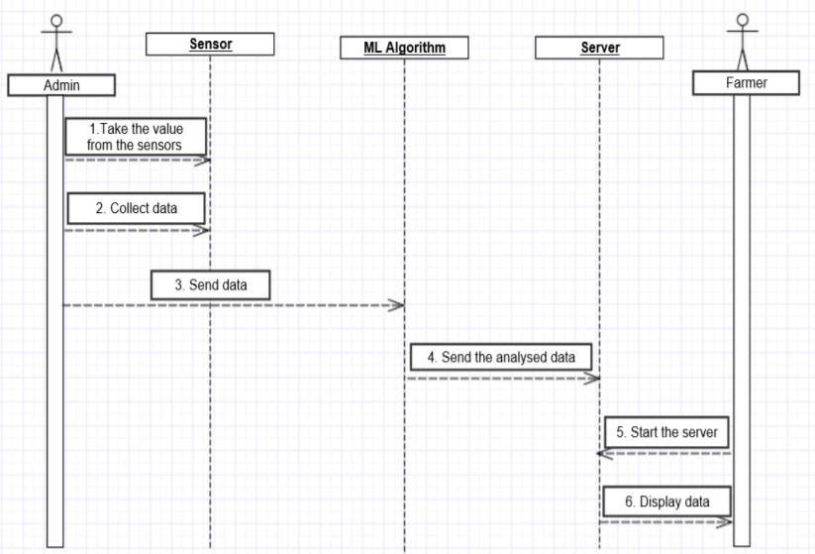
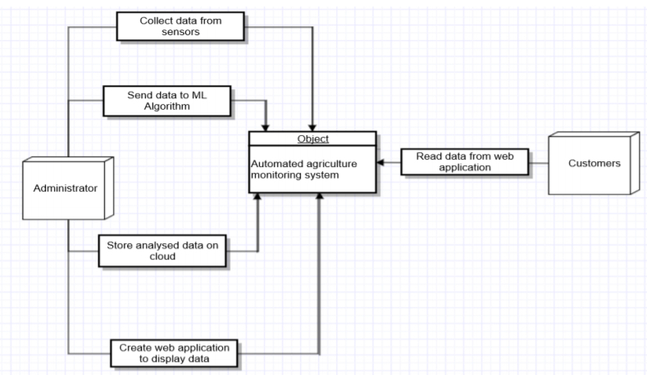
Sequence Diagram and context diagram
Sequence Diagram
Context Diagram

Slide 13
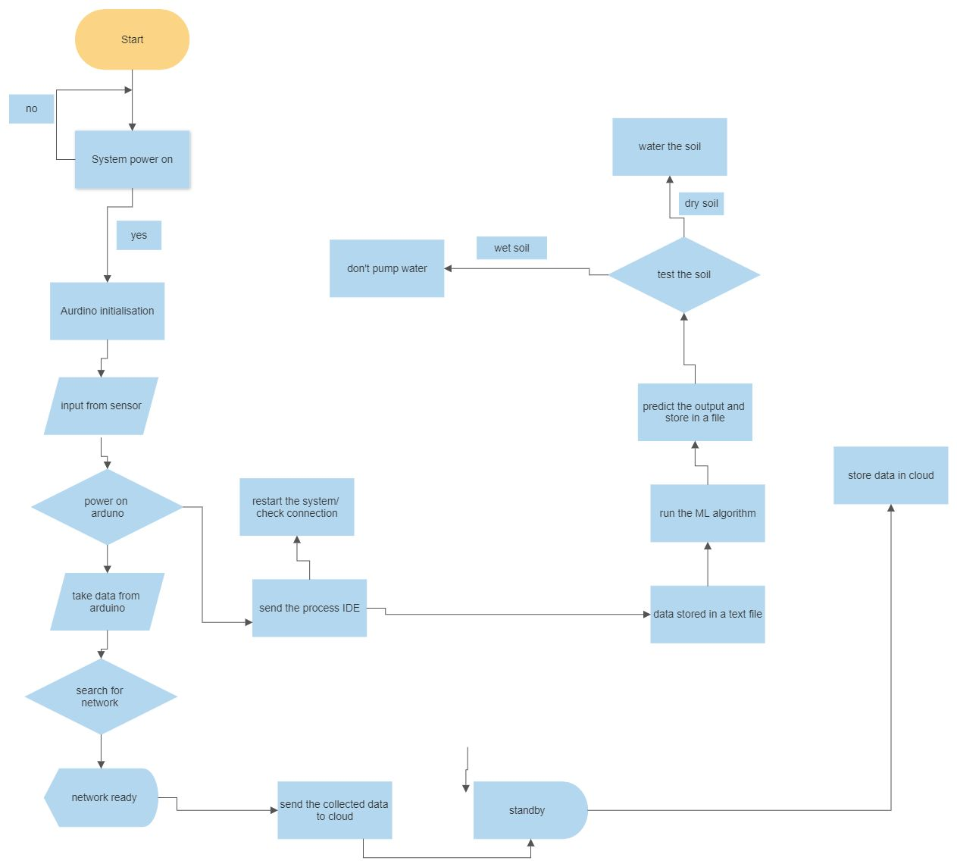
Flow Diagram

Slide 14
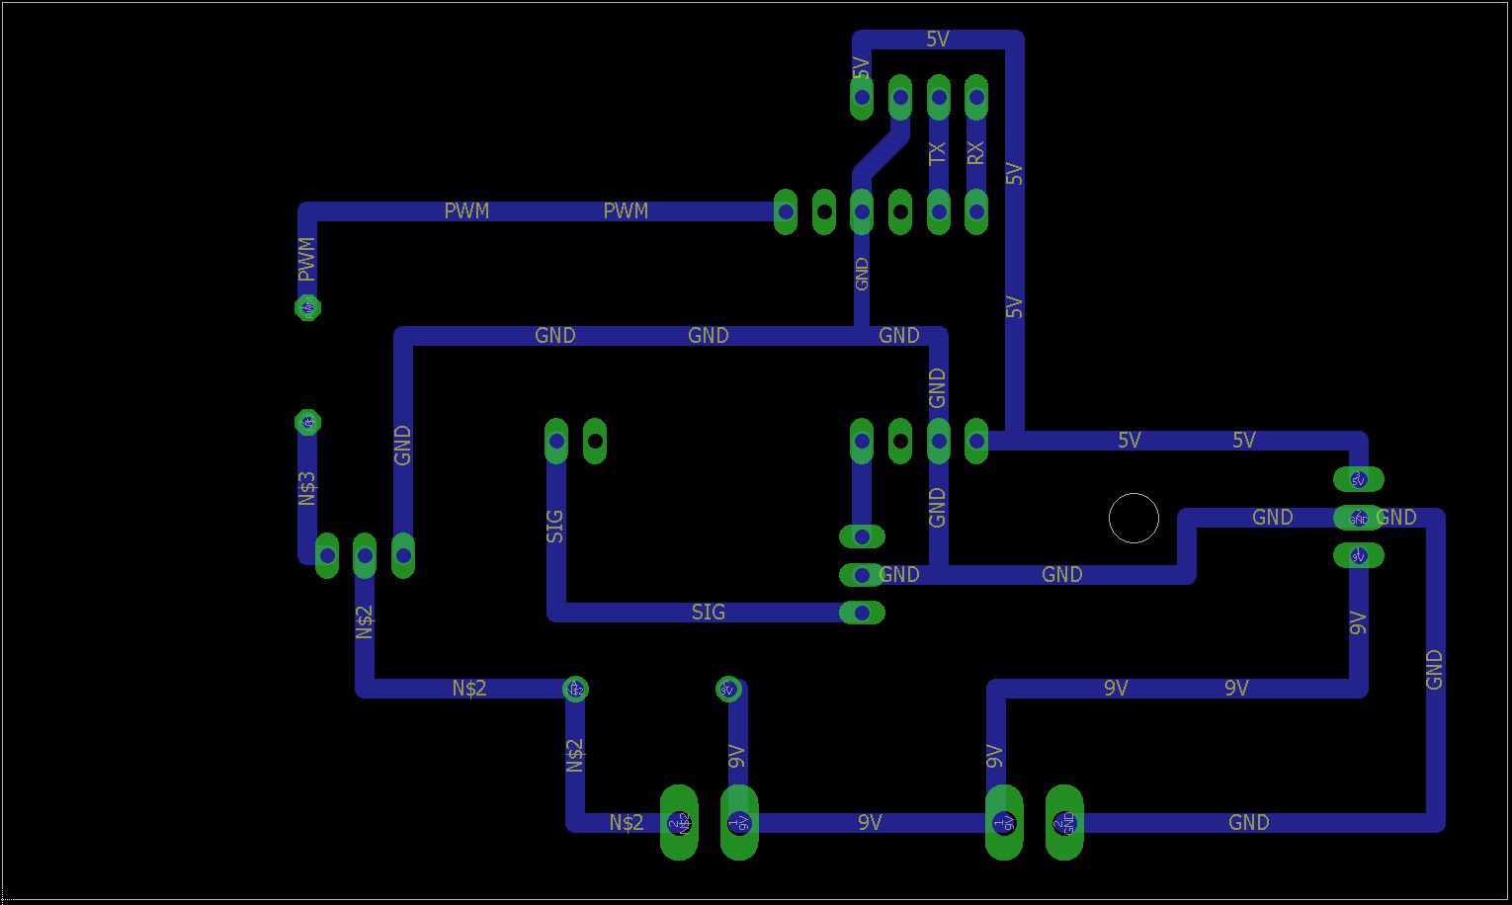
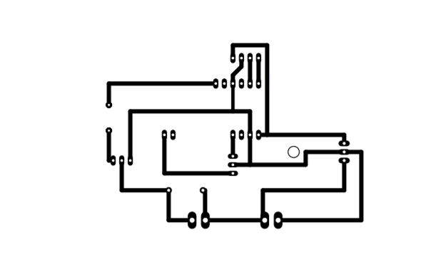
Custom Built PCB

Slide 15
work done so far
Designing the UI/UX for the mobile application.
Designing the logo for the application.
Creating a Virtual Server in AWS and practicing dynamic hosting.
Setting up the Arduino connections.
Designing the 3d model for the Base.
Programming
Circuit Design

Slide 16
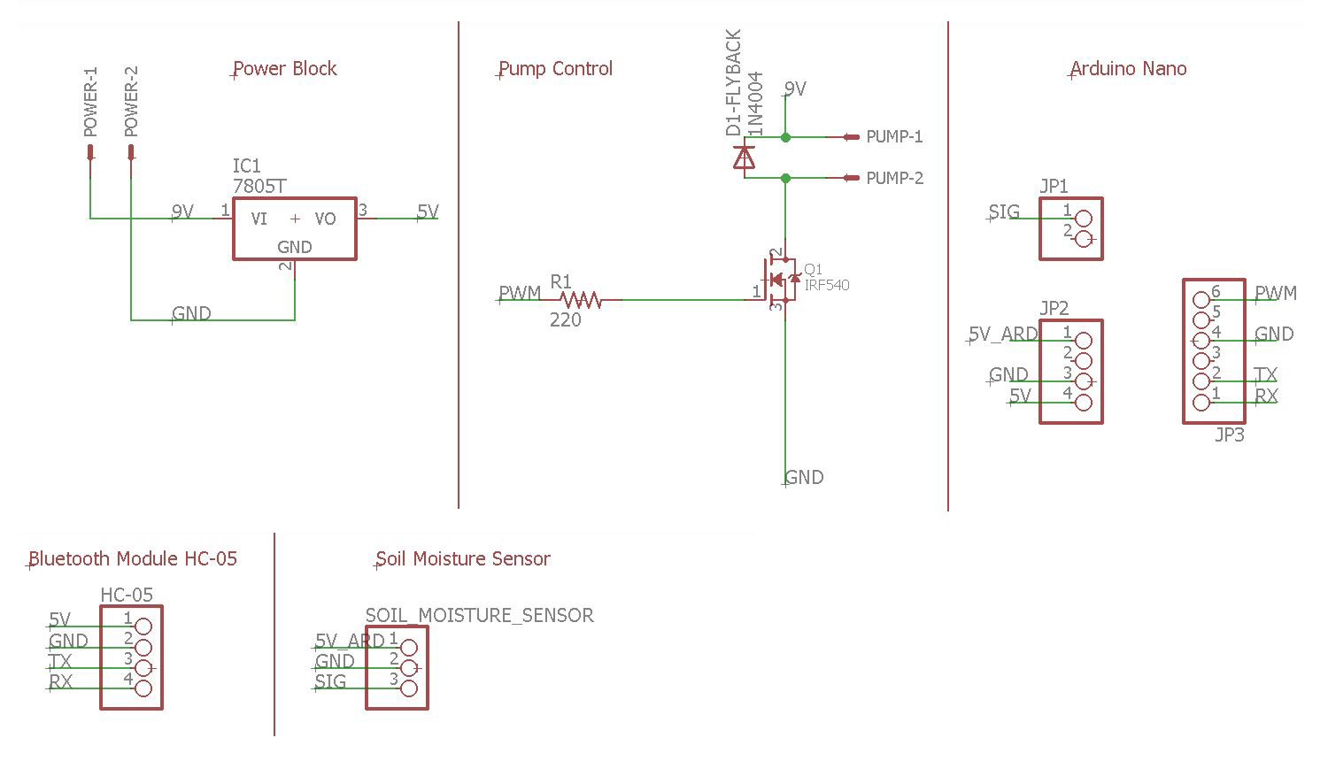
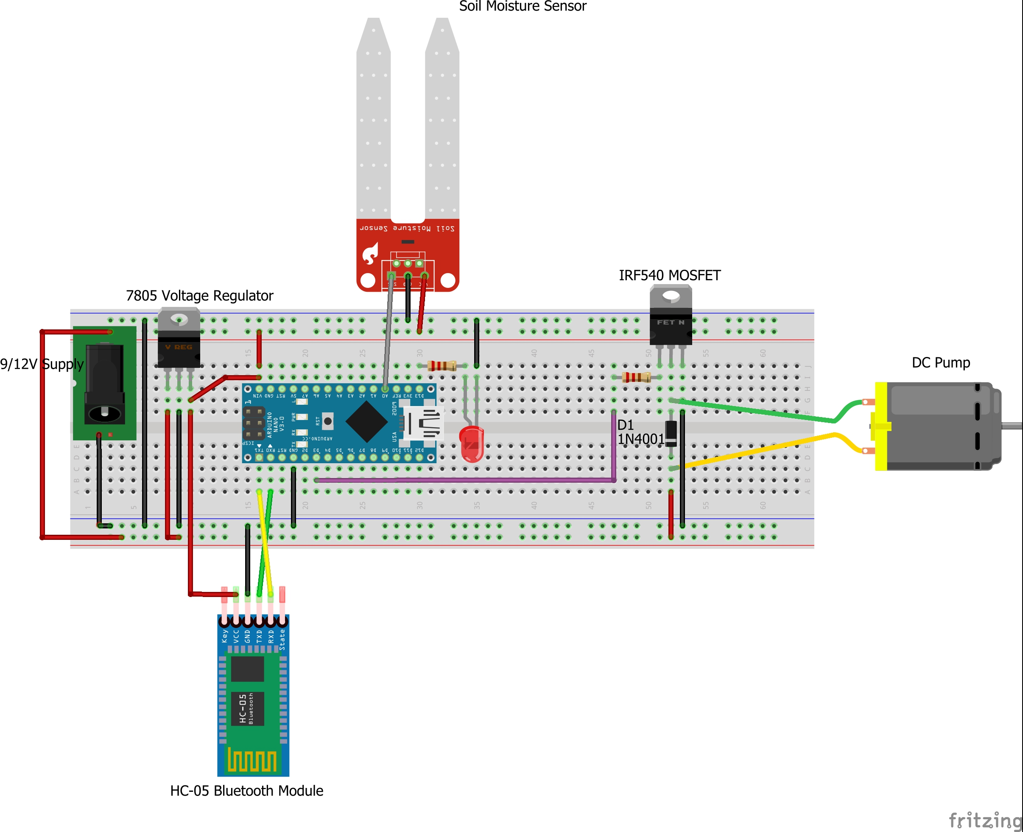
SYSTEM IMPLEMENTATION
Circuit Schematic Diagram of the System
Pictorial Circuit Diagram of the System

Slide 17
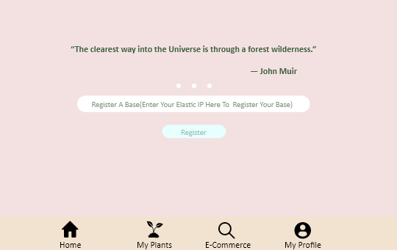
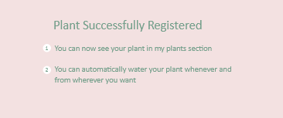
Home Page
Hover for successful registration

Slide 18
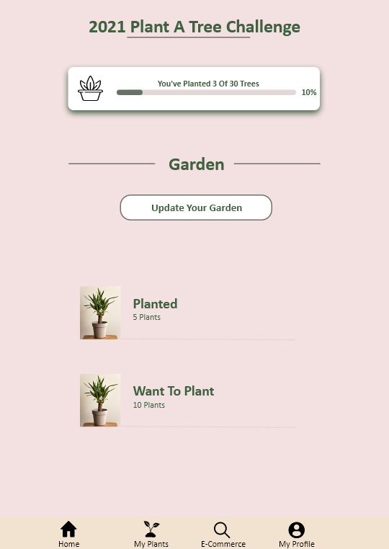
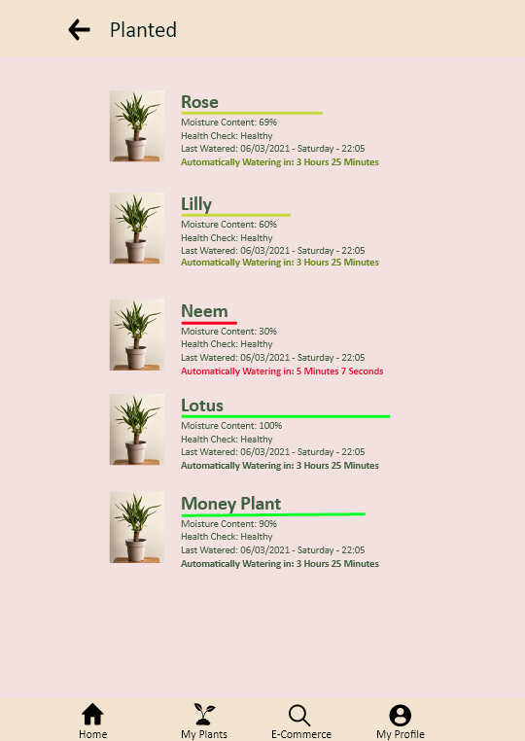
Dashboard Page
List of Plants Page

Slide 19
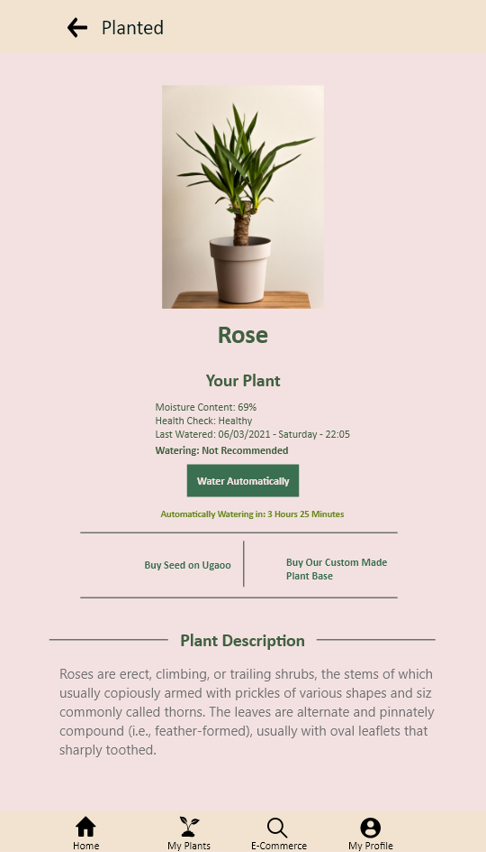
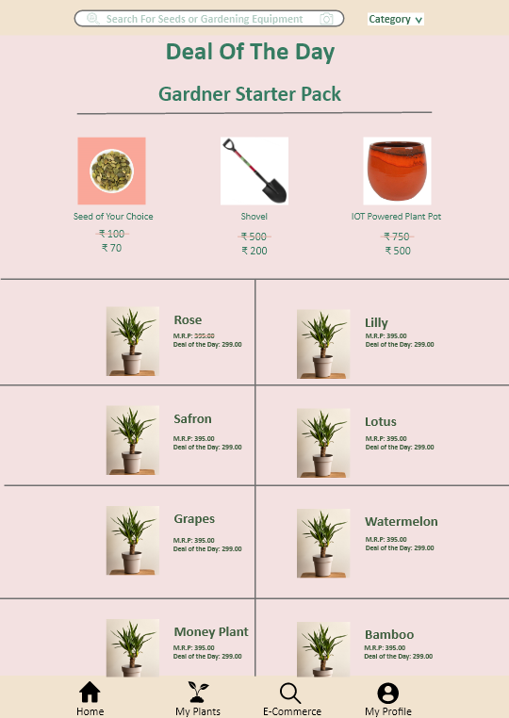
When a plant is selected
E-commerce Page

Slide 20
3d Models

Slide 21
Conclusion & Future
Although it seems to be more demanding and challenging, there are many other possibilities like creating complex connections of plants of similar variety.
Also, using more than one sensor is another idea for an experimental venture, but there are also many other experimental and challenge-like ideas such as using solar power supply, timer for setting irrigation system etc.
However, independently of the way used to construct it, there is no doubt that this system can be very helpful in solving many problems, from those that seem harmless to those that are on the scale of the most important and most dangerous ones for human population.
By means of this system, it is possible to control the amount of water released from the process of watering the plant.
Although it can be very helpful for humanity in general, agriculturists, craftsmen, and botanists are the people who could have the biggest benefits of using this system.

Slide 22
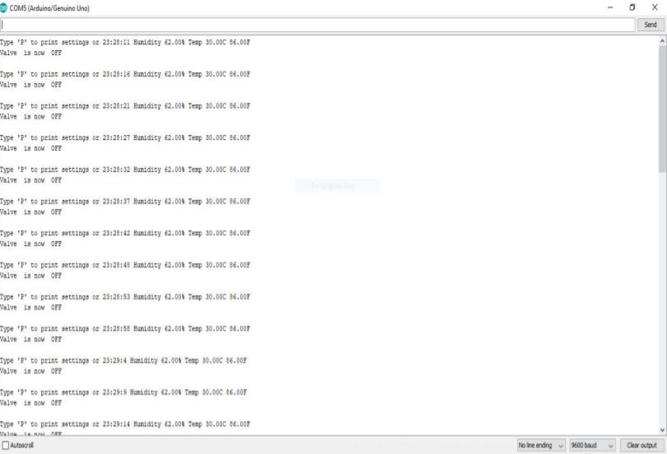
Testing & Implementation
Print Settings of the Valve:

Slide 23
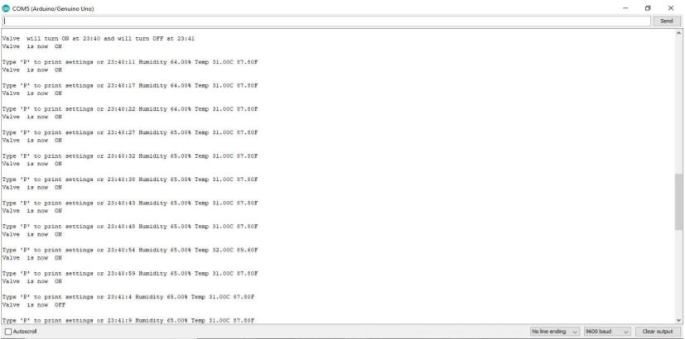
Testing & Implementation
Valve is Open When Humidity is less than 80% and Timer is Set

Slide 24
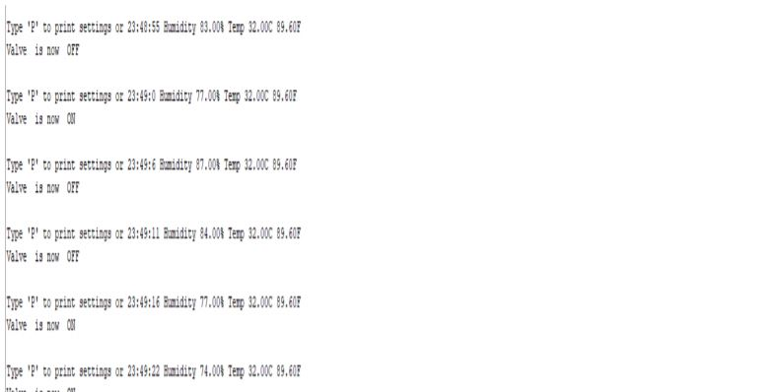
Testing & Implementation
Valve is Closed When Humidity is More Than 80% Even When the Timer is On

Slide 25
Thank You

